Slide 1
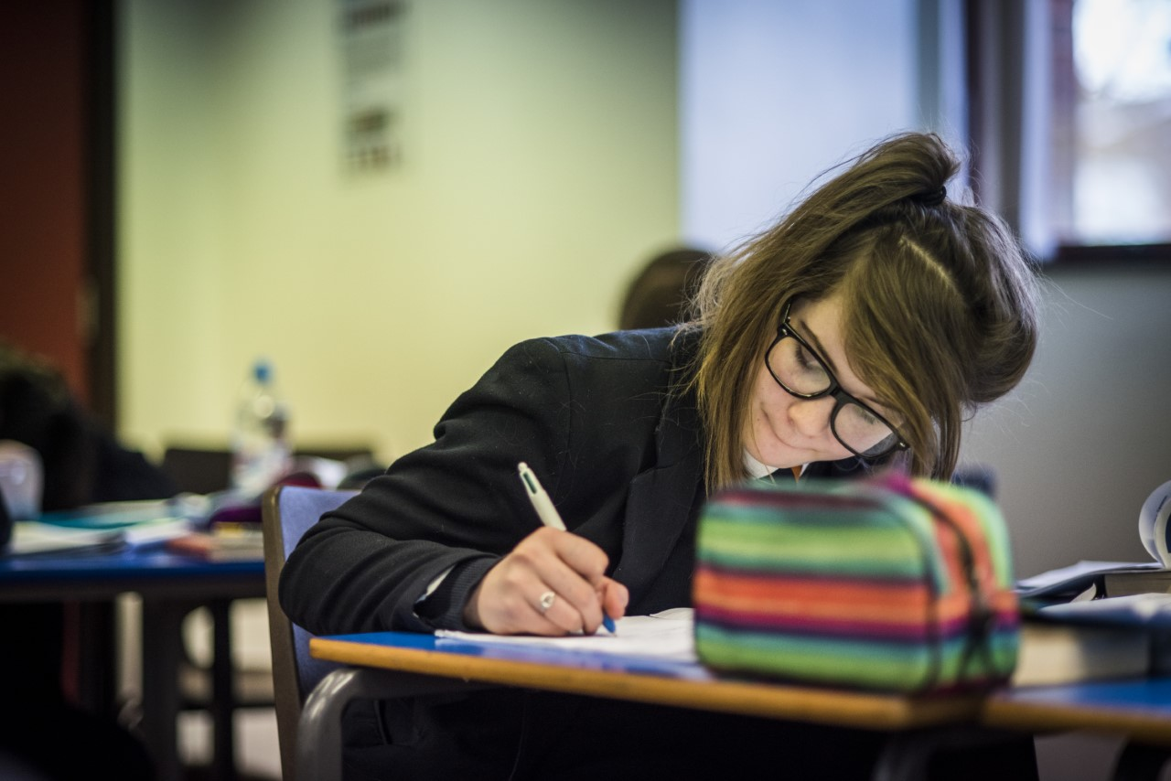
Mathematics at Trent College
Year 6 to 7 Transition

Slide 2
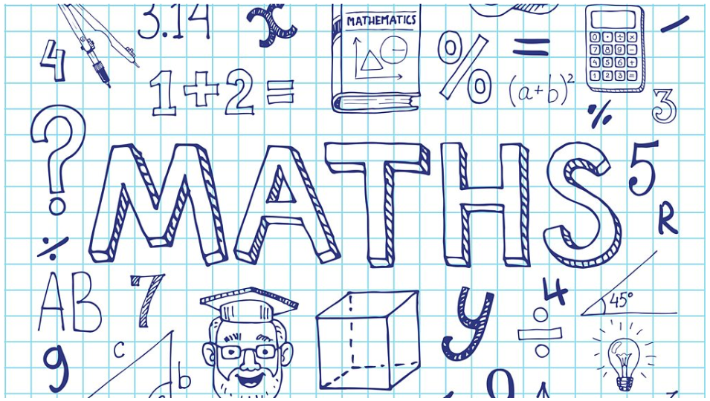
Who are the Maths Department teachers?
Mrs Howat - Head of Department
Mrs Sansom - Second in Department
Mr Brumby - Academic Deputy Head
Mr Noble - Head of Main School
Mrs Gale - Head of Year 9
Mr Bradwell - Assistant Head of Year 7
Mr Tarry
Dr Hansard
Ms Perry
Ms Shamsi
Mrs Sutton

Slide 3
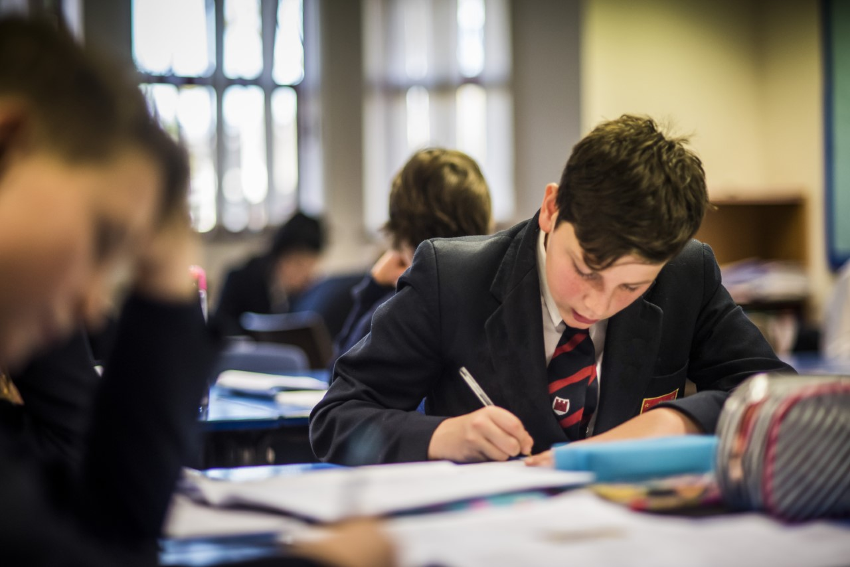
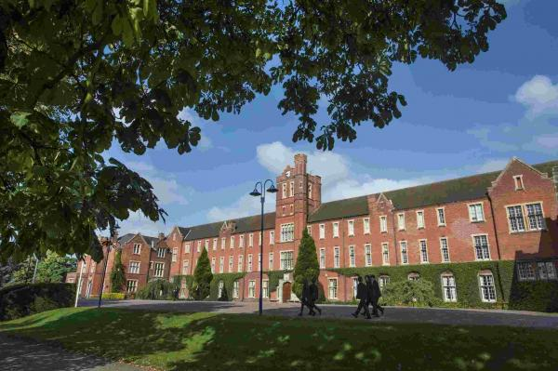
What does Maths look like at Trent?
8 lessons a fortnight
5 mixed ability groups to start with. Then a total of 6 classes made up of two set 1s, two set 2s and two set 3s.
Work through units at a comfortable pace suited to each class and have a Unit Test at the end of each completed unit.

Slide 4
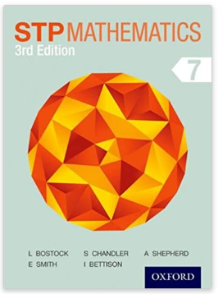
What will I be learning next year?
Michaelmas 1 – Pre-setting
Place Value and Approximation
Addition and Subtraction
Multiplication
Division
Ordering decimals
Operations with decimals
BIDMAS
Factors, Multiples, Prime Factors
LCM and HCF
Squares, Cubes and basic index numbers

Slide 5
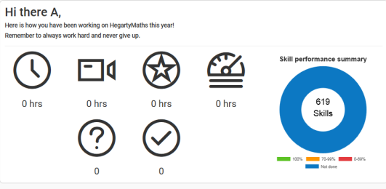
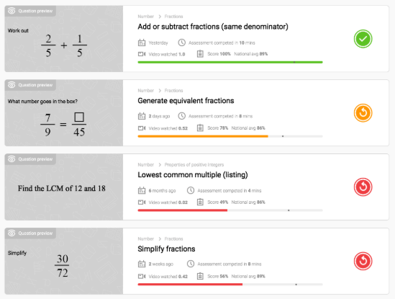
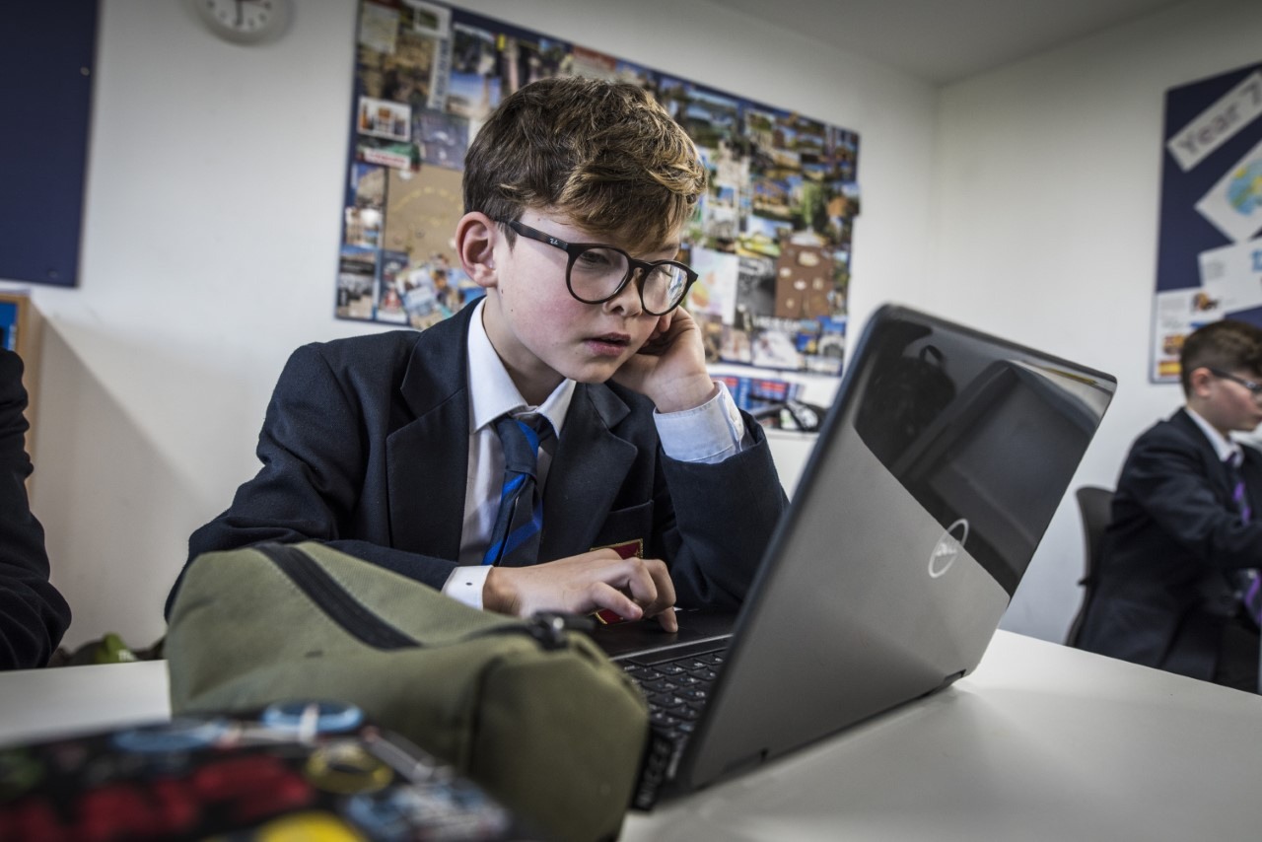

Slide 6
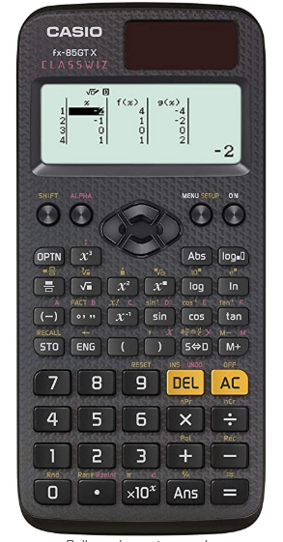
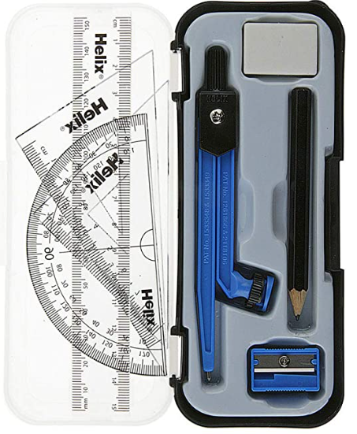
What can I be doing to prepare for September?
Practise:
Arithmetic skills including times tables
Written methods for decimal calculations
Understand simple ideas of fractions
Measure lines and angles
Draw basic charts
Find patterns in sequences of numbers
Casio FX-85GTX or 83GTX
(FX-85GT+ or 83GT+)
Maths Equipment
Ruler
Protractor
Compass

