Slide 1
Parents’ Transition Information
The next steps… Part 2

Slide 2
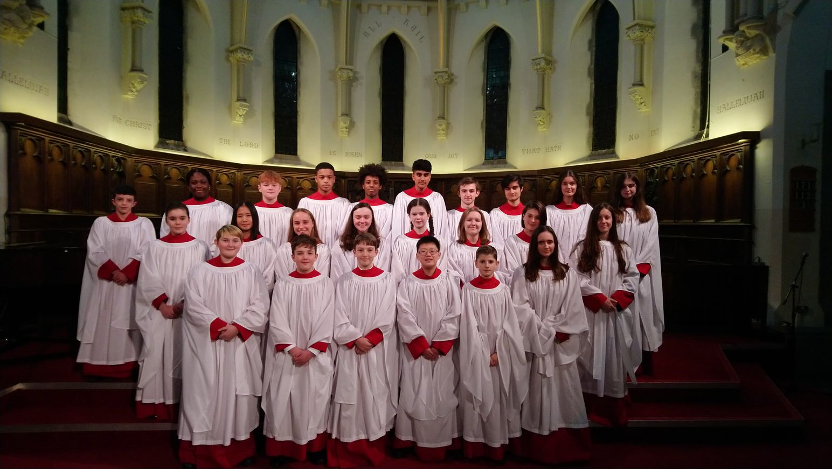
Music for all – ensemble provision
Students taking lessons are in the majority in Lower School
2 orchestras, 2 jazz bands, 4 choirs, 2 string groups, 2 wind bands, professionally coached School of Rock, etc.
Performance opportunities are open to all
      Your support in encouraging students is very much appreciated!
Ensembles are mostly by stage, not age
Registration periods, lunch time and after school are all used

Slide 3
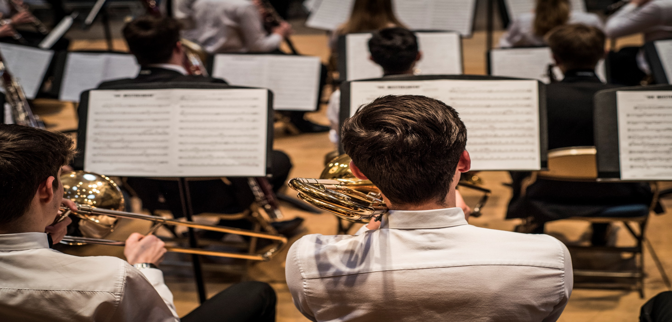
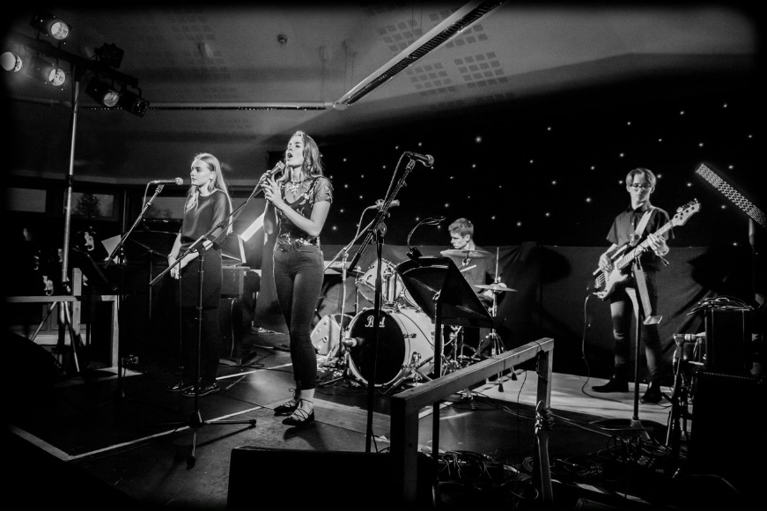
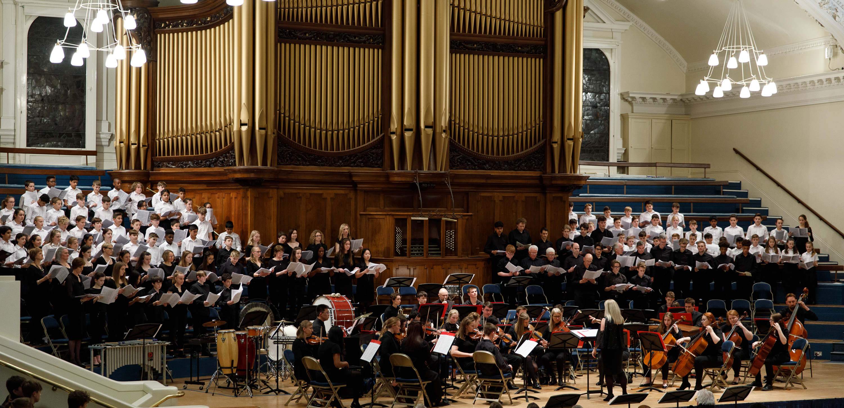
Performance platforms
Drive-time concerts
Large-scale performances
Gigs, cabarets and competitions
A wide variety of experiences
All of Year 7 perform in the annual Spring Concert at Nottingham’s Albert Hall

Slide 4
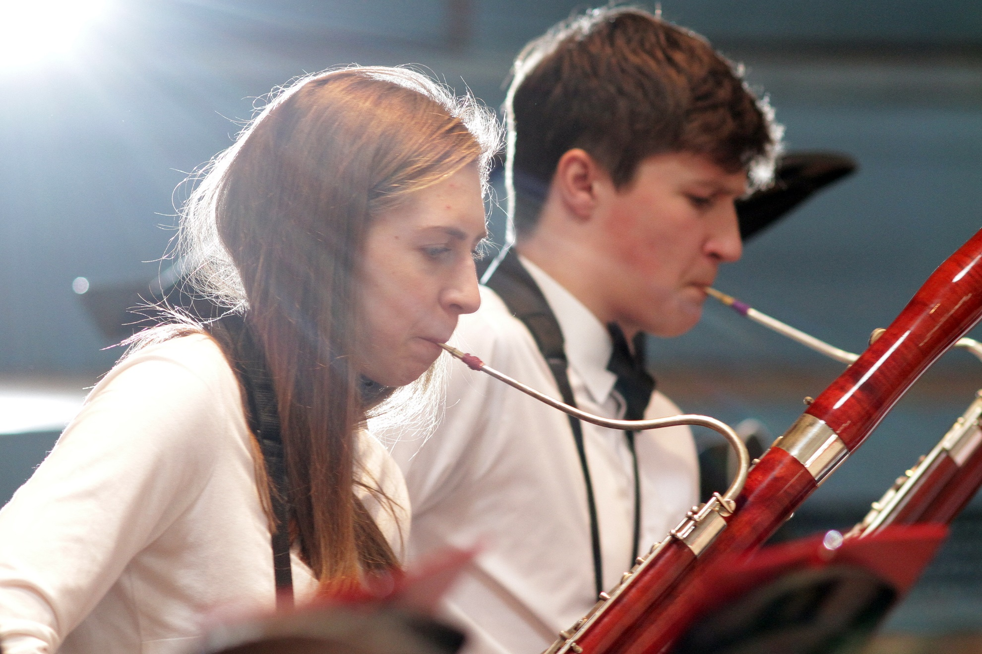










Music with everyone
Joining ensembles outside of Trent is encouraged
Visiting artists have included the Band of the Grenadier Guards, and masterclasses with top professionals
    Ask teachers or Director of Music for details
Helpful if you let us know if students are having lessons outside of school

Slide 5


Sport at Trent
Mr Richard Mahony (Director of Sport)
@TrentSport

Slide 6


Building on Success
Our Vision
‘To have a relentless focus on the pursuit of excellence, absolute commitment to increasing participation and pushing Trent College to the forefront of regional and national competition’
@TrentSport
Participation - Progression - Performance

Slide 7
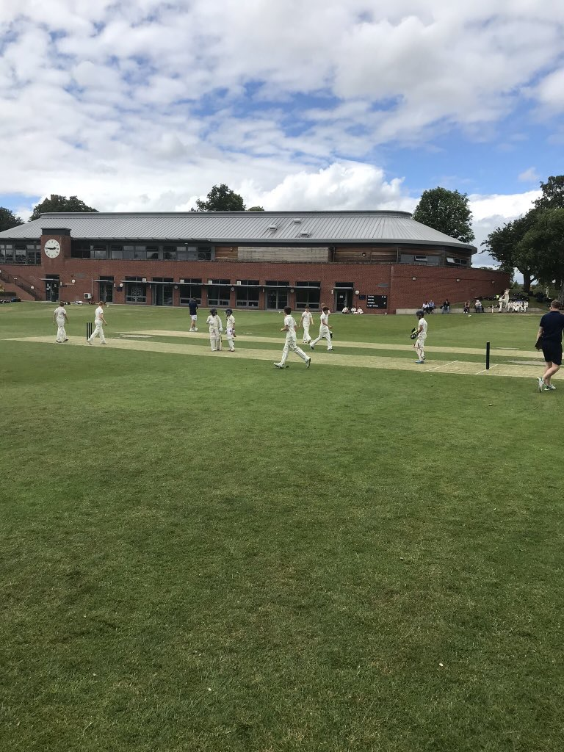
Our Philosophy - @TrentSport
Participation
Progression
Performance
Participation - Progression - Performance

Slide 8
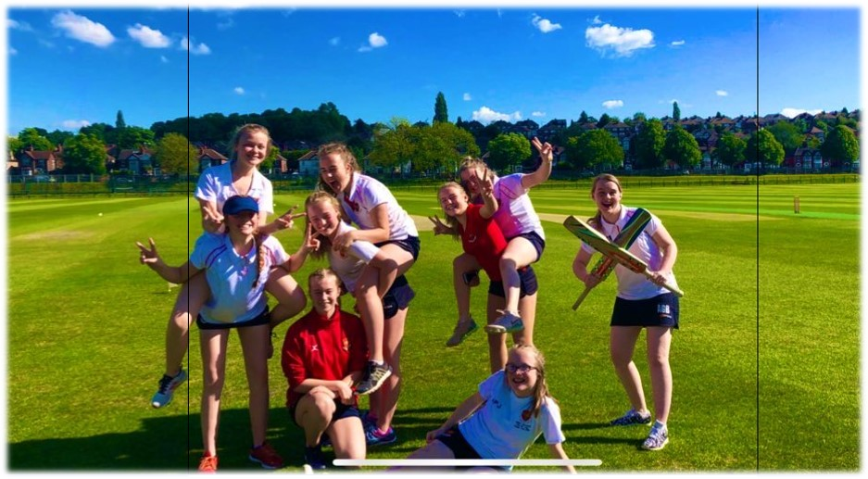
Our Sports Provision @TrentSport
Games
Physical Education
Co – Curricular Sport

Slide 9
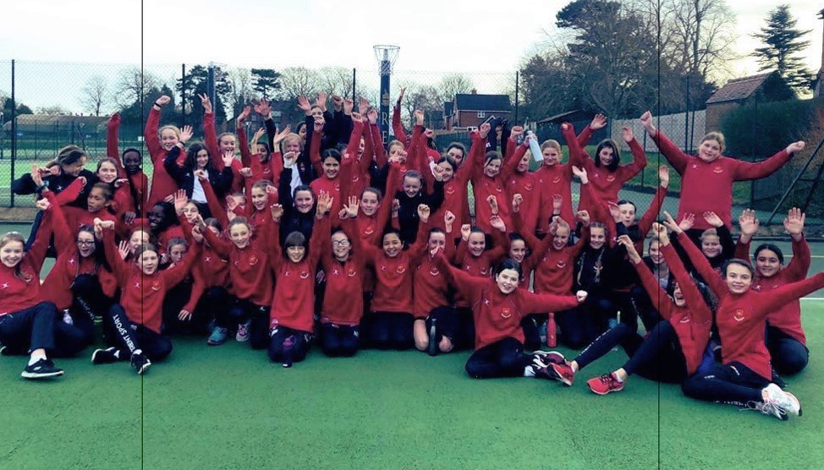
On your marks for September!
Rugby (Games) – Gum shield, rugby/football boots, games kit
Hockey (Games) – Gum shield, hockey stick, games kit
Physical Education – White socks, trainers, PE kit
@TrentSport

Slide 10
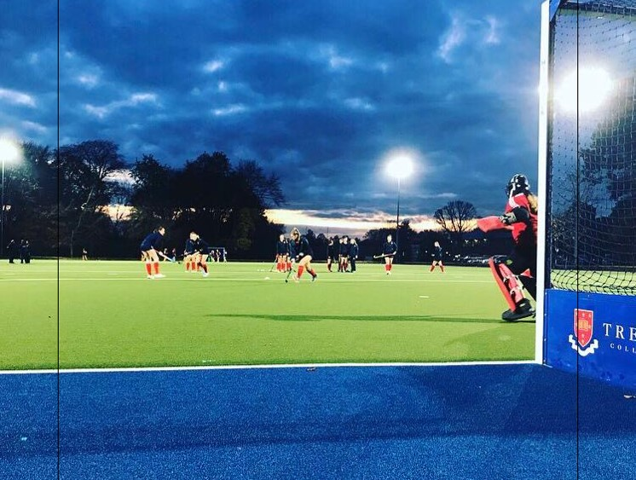

Our Communication Platforms
www.trentcollegesport.net
@TrentSport
iSAMS
Noticeboards
Participation - Progression - Performance

Slide 11
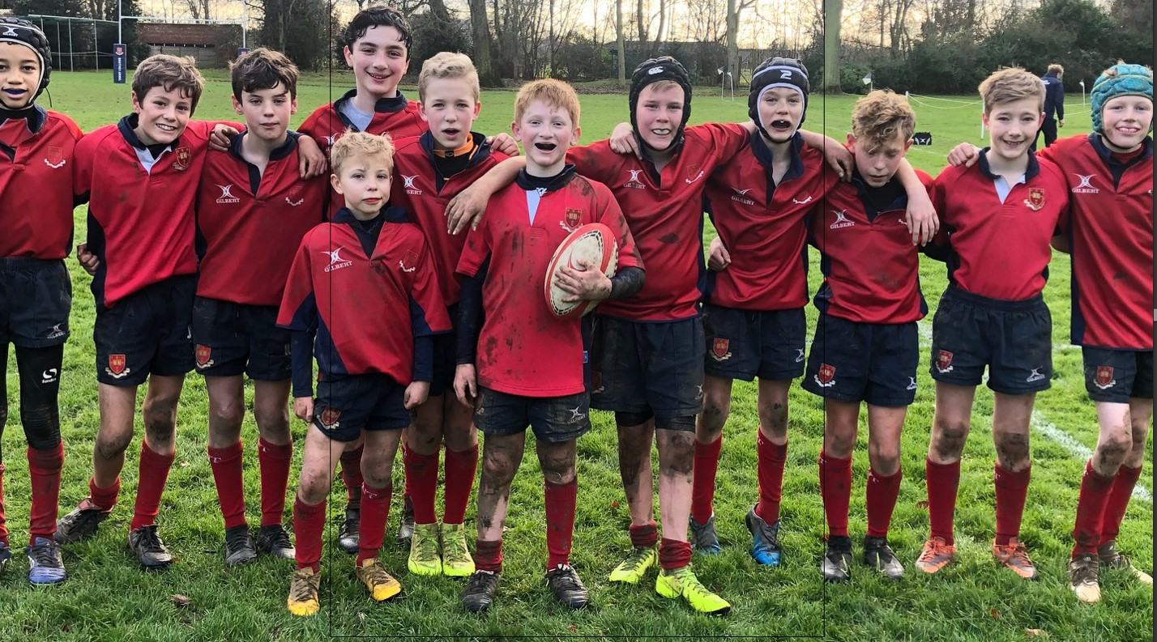
See you soon!
‘Hard work beats talent if talent doesn’t work hard!’
@TrentSport

Slide 12

LAMDA (The London Academy of Music and Drama)
Application forms will be available in early July

Slide 13

Top Transition Tips

