Slide 1
Getting started on your Post Trent Journey 18.5.23

Slide 2
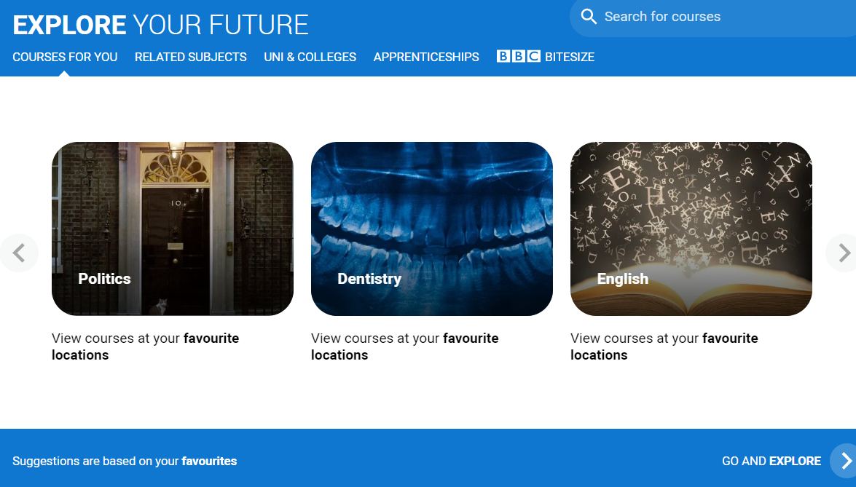
Over the next few weeks..
Understand all your options
Register with the UCAS Hub to start your research
Work with your Tutor and Careers to plan
Getting your parents involved too
Getting your UCAS Application started
Understand Personal Statements
UCAS Discovery Fair

Slide 3
Starting your research
Register with the UCAS Hub to:
explore careers, subjects, places, and apprenticeships
find and favourite over 35,000 courses
search for open days, events and virtual tours
turn predicted grades into UCAS Tariff points
speak to those in the know using Unibuddy
speak to career, higher education, and application specialists by attending Hub lives
take the UCAS Quiz to find your career matches
start your application

Slide 4
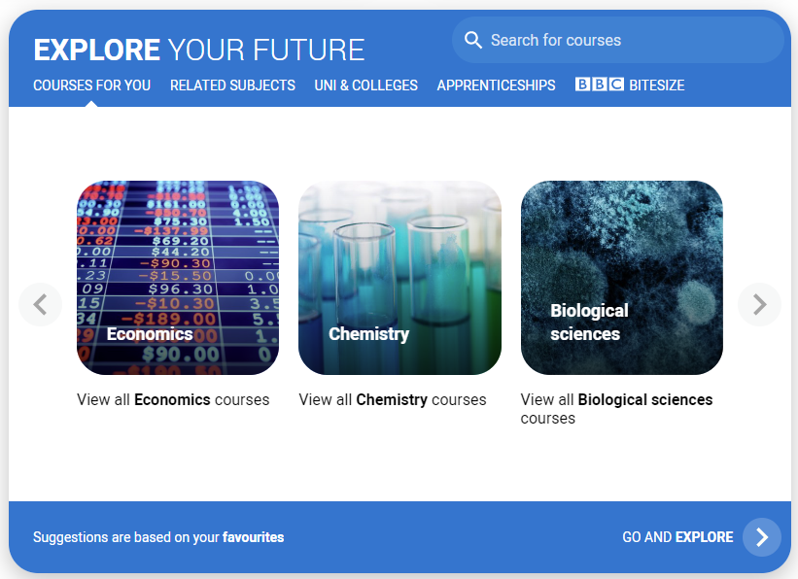
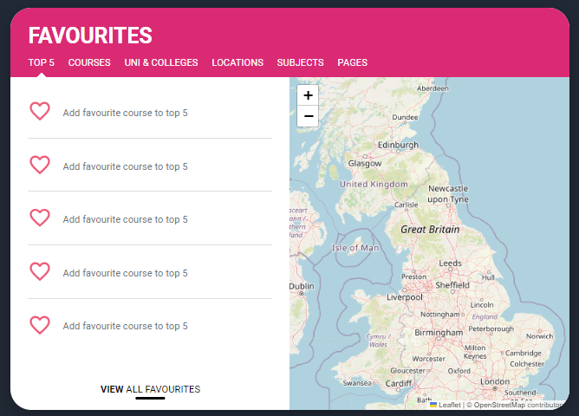
Personalised tools to help
Tools to help
Explore your future
Discover what to do with subject, industry, and career guides; discover where to go with city, employer and accommodation information. Explore apprenticeships and course opportunities for you. Favourite as you go.
Your favourites
Search for courses, use to decide your top 5 choices, manage, keep those favourite information pages to hand. Manage and edit at any time.

Slide 5
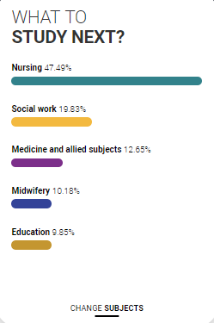
Personalised tools to help
UCAS Quiz
Find job and career ideas matched to your personality.
Plus a list of courses previous students studied in order to get there.
What to study next?
Broaden your horizons by exploring another subject area, that student’s who did your qualification went on to study.

Slide 6
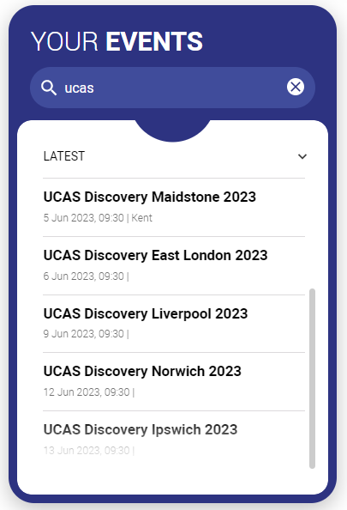
Our advice and events
UCAS Hub lives
Join our live sessions hosted by expert panels.
Ask questions to help you make an informed decision about the right path for you. University, apprenticeships or the world of work.
UCAS Discovery
Events and open days are presented based on your preferences.
Register straight from the Hub for our UCAS Discovery ‘The Big Q&A Tour’, with exciting new zones covering all pathways.

Slide 7
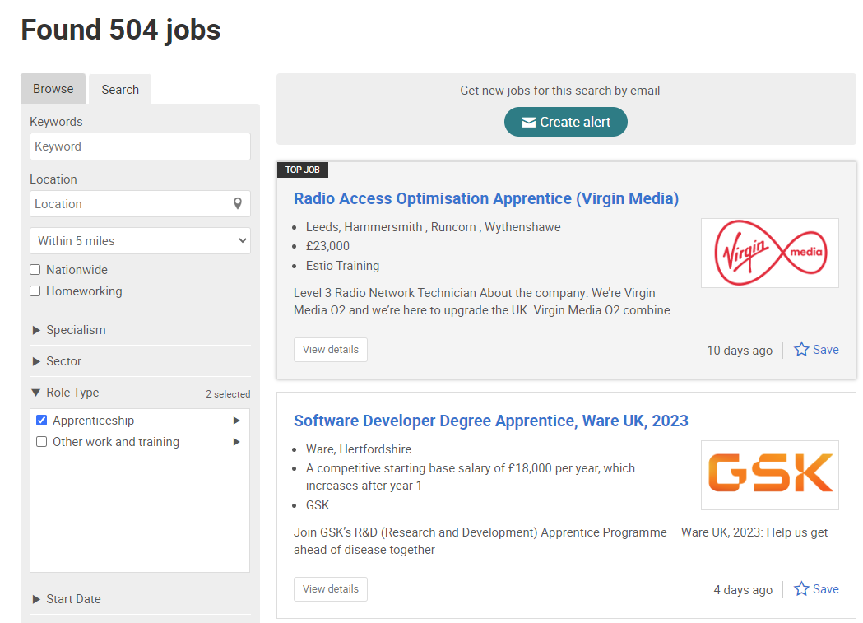
UCAS Exploring Apprenticeships
From UCAS Hub you can easily explore apprenticeships; learn more information and see a live selection of apprenticeship vacancies.
Set alerts to stay up to date.

Slide 8
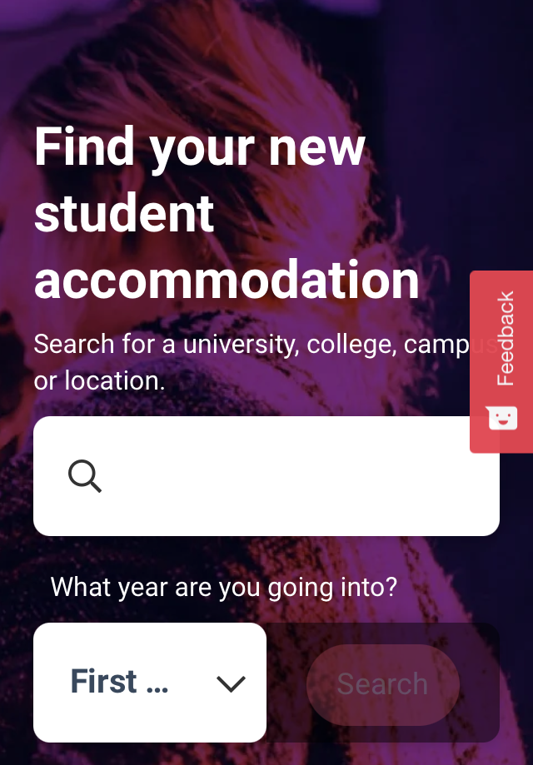
What else do you need?
Accommodation
High on the list when considering where to study, but it’s not always easy to compare what’s on offer. Understand what options there are using our accommodation search.
Personal Statement Builder
Designed to help you think about what to include, and how to lay it all out. It counts how many characters you’ve used, so it’s easy to see when you’re close to the 4,000 character limit.

Slide 9
Getting Started

Slide 10
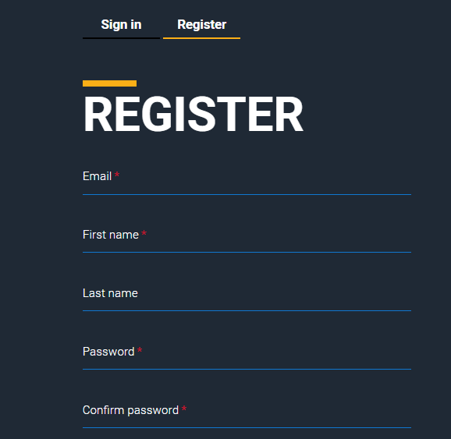

Slide 12
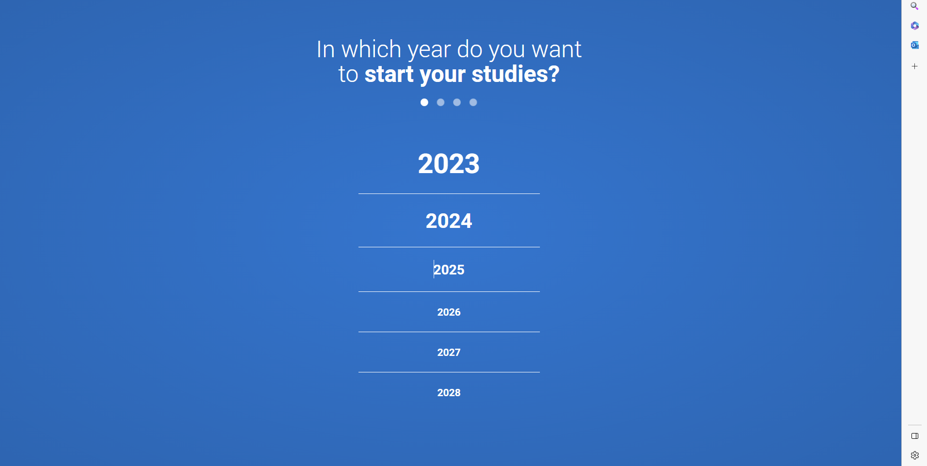

Slide 14
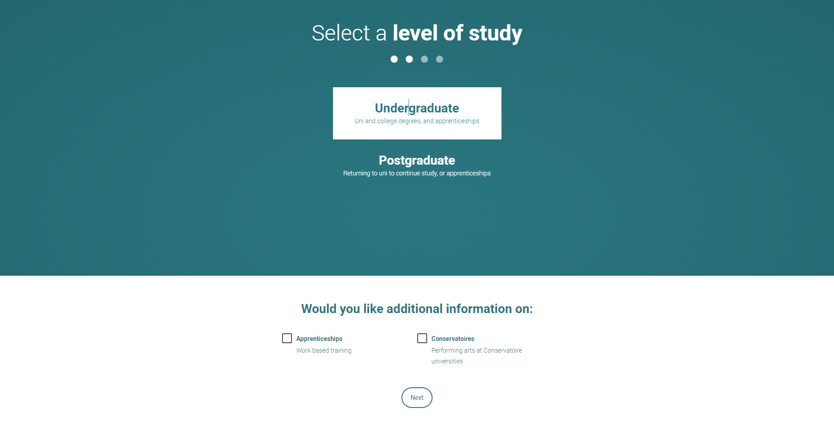

Slide 19
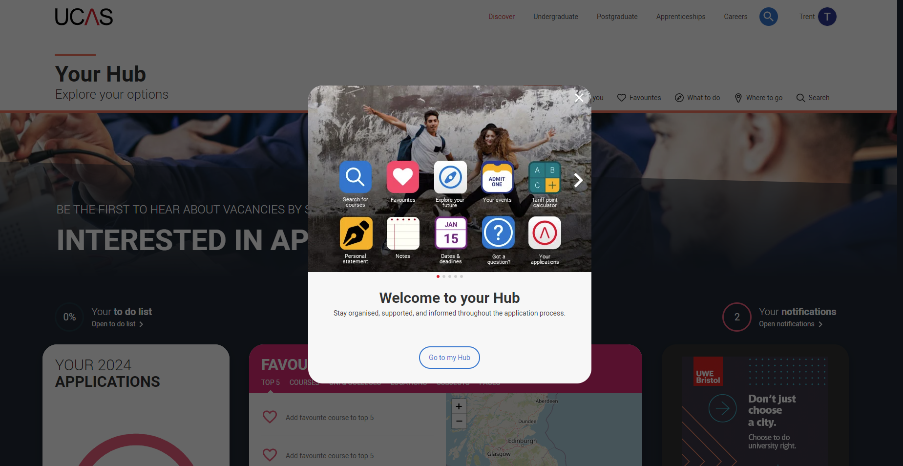

Slide 20
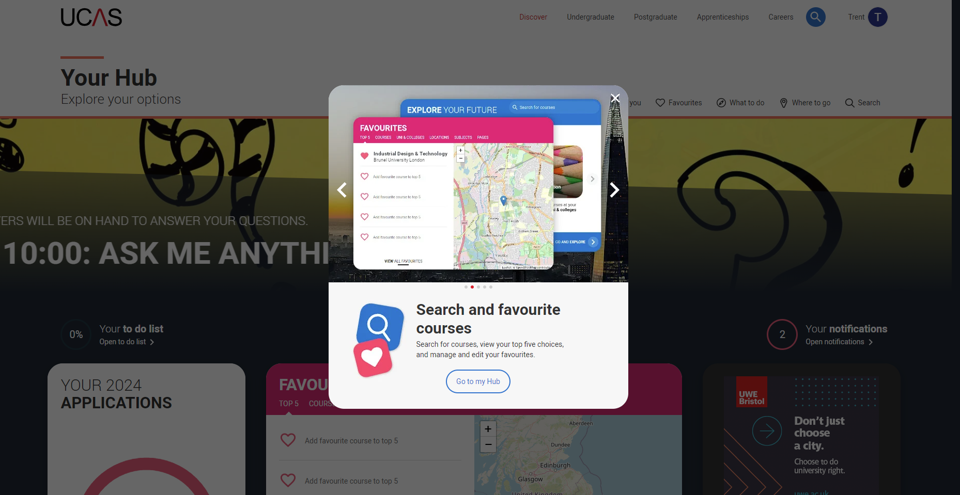

Slide 21
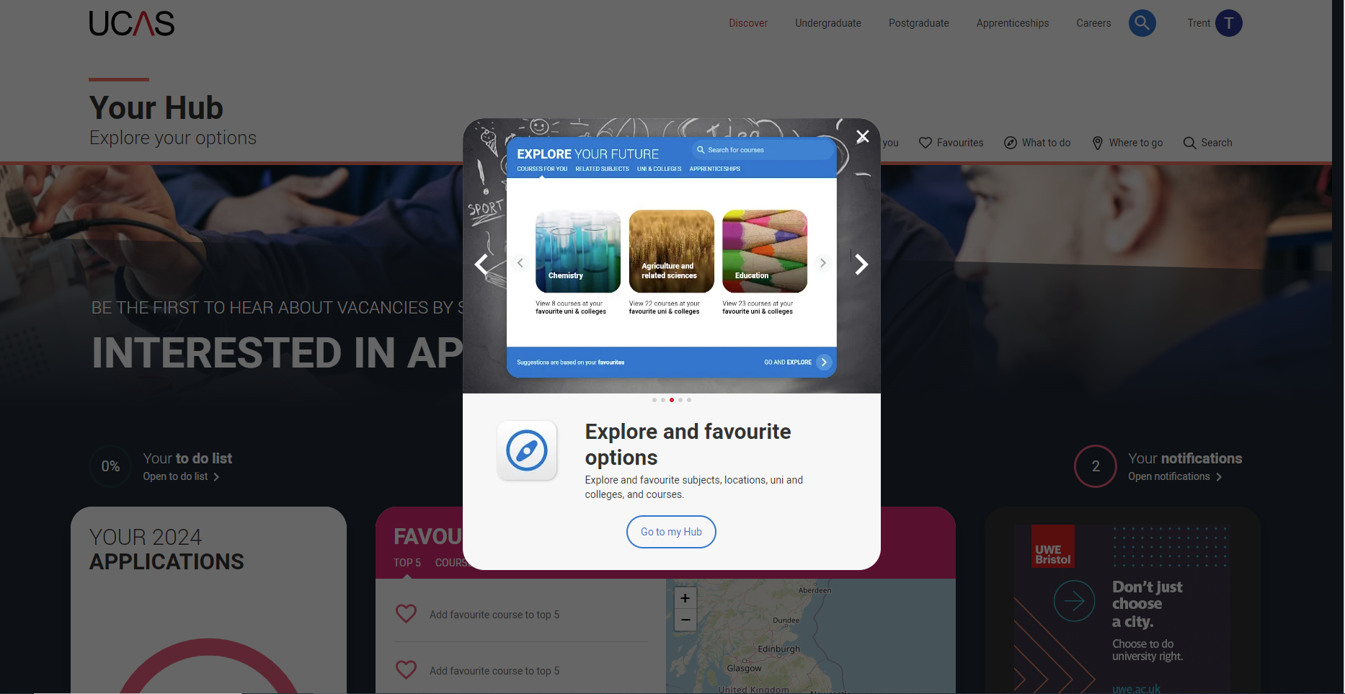

Slide 23
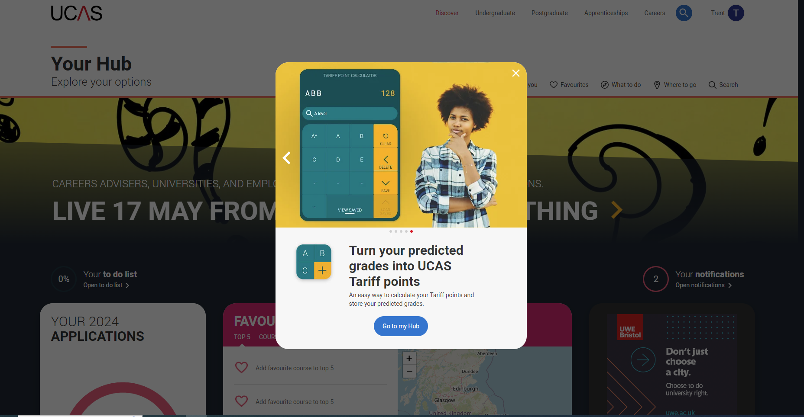

Slide 25
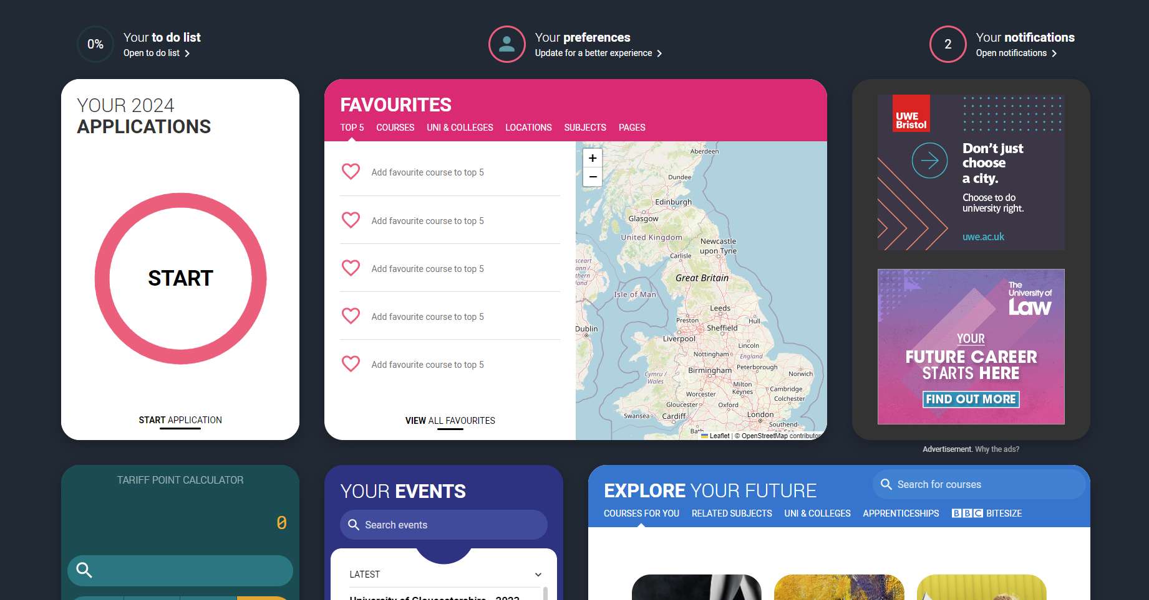

Slide 26
Register here

