Slide 1
Year 12 Post Trent Options
25.5.23

Slide 2
Where would you like to go?
What is it like out there?
How do you get there?
Timescales
Ensuring your success

Slide 3
Where do you want to go, what do you want to do??
This is simple – you need to apply to the best course, apprenticeship, gap year or job for YOU
For the best prospects in the future, it’s YOU, not where you go that is important
For example - in the Investment Banking sector 76% of jobs went to interns (work experience)
70% of graduate employers have no degree subject specification

Slide 4
QUESTION #1 - Routes
Name 4 possible routes you could take after you leave Trent
University – UK or abroad
Apprenticeship
Gap year
Work

Slide 5
Routes
You could apply to more than one route –
Thorough research
Effective Planning
Comprehensive Preparation

Slide 6
QUESTION #2 – The Landscape
So what’s it like out there?
Is the UK demographic of 18 year olds set to rise or decline imminently?
Due to rise dramatically (there are predicted to be 1 million students going to university by 2030, currently 750k)

Slide 7
The Landscape
More 18 year olds will go onto Higher Education
A much wider range of the population will go too
Places will be more competitive
Entry requirements may increase
But.. the very best students will still get in
And this is not just about their grades

Slide 8
The Landscape
The impact on you:
You will need to be flexible.
Don’t put all your eggs in one basket.
Be as impressive as you can be.
Be realistic!

Slide 9
The Landscape
A*A*AA predictions

Slide 10
QUESTION #3 - University
If a course asks for AAB is this the same as getting 128 UCAS points?
It may be yes but mostly where a course asks for grades, this is what they want
Do my EPQ / D of E / Lamda / Music results count toward UCAS Points?
Sometimes yes, but please check with the uni. EPQ Gr A will reduce your offer at some unis.
How many universities do you apply to on your UCAS form?
You apply to up to 5 universities on one application
What are FIRM and INSURANCE choices on your UCAS form?
These are the two courses you choose from your range of offers, your first and second choices.
How many Dentistry/Medicine/Veterinary courses can you apply to on one UCAS application?
You can apply to up to 4 Medicine, Dentistry, Veterinary Science courses and 1 other.
Can you apply to more than one course at the same university?
Yes of course
Can you apply to more than one type of course on your UCAS form, eg: History, English Literature?
Yes, although you will only write 1 Personal Statement, which will be seen by all applications
Do you have to attend an interview for all courses?
No, but some do and you will need to prepare.

Slide 11
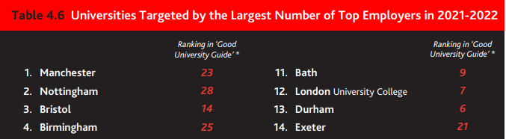
University
League tables do not always show the best options
Birmingham, Manchester, Bristol, Nottingham, Leeds universities – great graduate job outcomes but aren’t the top in league tables

Slide 12
University
Look at a range of entry requirements at a range of institutions to give yourself the best chance.
Be curious, look at a range of different courses, not just the ones you’ve heard about!
Read the COURSE MODULES thoroughly, will I enjoy three years studying this subject?

Slide 13
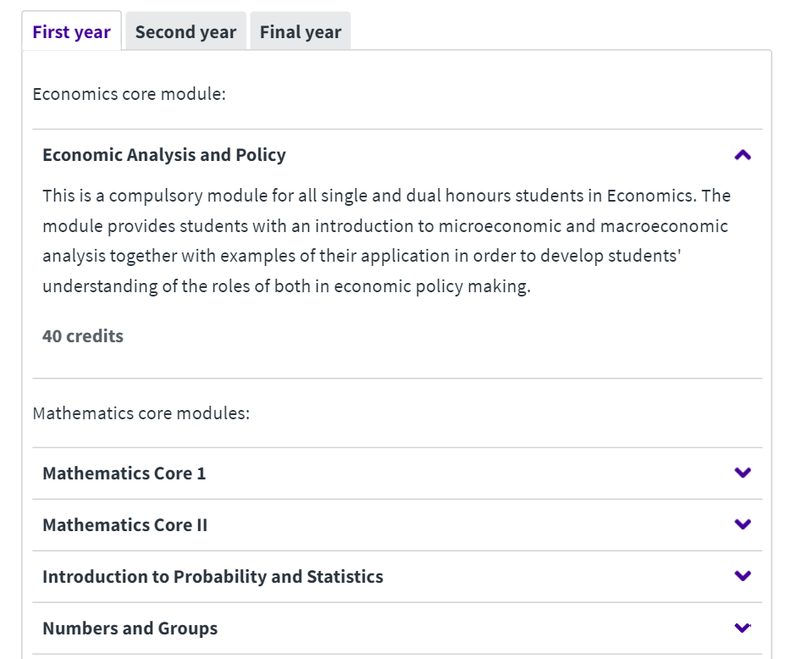
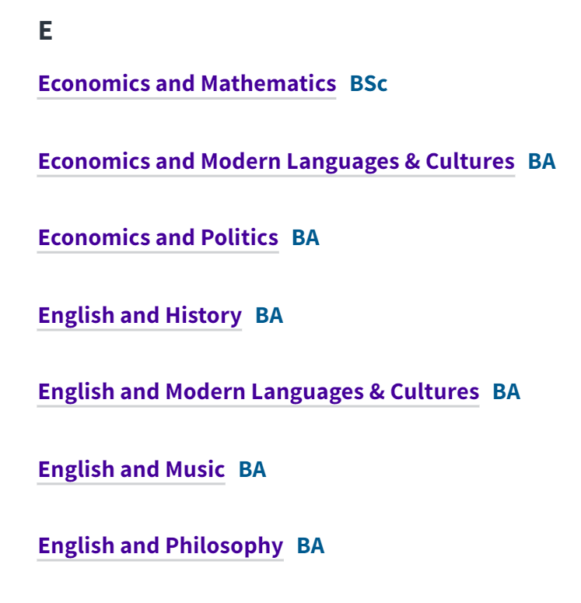
University

Slide 14
QUESTIONS #4 – University Dates
Thinking about UK universities – when are the following deadlines:
What is the first date you can submit a UCAS form for 2024 entry?
You can submit your application from 5th Sept 2023
Deadline for Conservatoires (music only)
Conservatoire music applications 2nd Oct 2023
Deadline for Oxford, Cambridge, Veterinary Science Medicine and Dentistry?
16th Oct 2023 (13th)
Compulsory entrance exams for Oxbridge, Medicine etc are 18/19/20th Oct 2023
The final UCAS deadline (called the Equal Consideration Deadline)?
UCAS (Equal Consideration) deadline is 31st Jan 2024 but…
School UCAS Deadline 8th Dec 2023
When do unis need to respond to you with an offer and when do you need to reply to them?
Unis have until 1st May 2024 to make you an offer and you have until 29th May 2024 to respond (TBC)

Slide 15
Process
Student
Careers
UCAS form completed in school
UCAS
Tutor
Research
Decision on course (based on predicted grades, discuss with tutor)
Personal statement work with tutor on Unifrog
Mrs Starbuck checks and signs off statement
Tutor informs Mrs Starbuck
Tutor approves statement
Tutor adds Reference Section 3 & Predicted Grades to UCAS (Section 1/2 PSM FES)
Students submits UCAS form – pay and send
Mrs Starbuck gives go ahead to pupil to upload statement to UCAS
Student receives confirmation email from UCAS
If NO changes, Mr Mayfield checks references and sends form to UCAS
UCAS forms come to school to be checked
Changes complete and form resubmitted by pupil
If changes required, form returned to pupil
Interview Invite / OFFERS!

Slide 16
QUESTIONS #5 – Study outside the UK
Can you apply to the UK and another country in the same year?
Yes of course
Do all countries have a system like UCAS?
Many do, but some countries you apply directly, do your homework
Can you apply to the USA for a scholarship in any sport?
No, for example, Field Hockey is only available for women
What are the timescales for a US application?
Earlier than the UK, make sure you’re in contact with us ASAP if you’re interested.
Do I have to be a citizen of that particular country to apply?
No you don’t, in some places it’s easier but most countries have non citizen application processes.
Is the USA a back up option?
No! Oxford and Cambridge wouldn’t make it onto the list of the most selective unis in the US

Slide 17
Study outside the UK
Can offer a fantastic opportunity to study in a new environment and experience new cultures
Courses will have different entry dates / methods and start dates
Speak to us asap

Slide 18
QUESTIONS #6 - Apprenticeships
When can you submit an apprenticeship application?
When the specific scheme opens, this could be throughout Y13
How many apprenticeships can you apply to?
As many as you like, it pays to be prepared!
How do you apply to an apprenticeship?
Directly with the employer, usually on their website
Will I be interviewed for an apprenticeship?
Almost certainly yes, it may be a 3-4 stage process
How do I find an apprenticeship?
Company websites, Gov.uk/apprenticeships, Unifrog, Networking

Slide 19
APPRENTICESHIPS
Do your homework now in preparation for Y13
Apply to a range of schemes
Evidence of interest in the company - Work Experience?
Interview practice
Seek help and guidance

Slide 20
QUESTION #7 - Research
If you have no idea what you’d like to do, or want to find out more, where can you do your research?
UCAS
Unifrog
Unibuddy
Careers Department
Tutor / Sixth Form Team
Family / Contacts
Work Experience

Slide 21
QUESTIONS #8 - How do you get there?
What will make you stand out from the competition for a course at uni, an apprenticeship, job or gap year?
Passion
Curiosity
Grades
Preparation
Attributes
Experience

Slide 22
How do you get there?
You will need to be the most competitive you can be
What will set you apart from your competition?
Do you meet all the required qualifications, experience and attributes?
How do you demonstrate these – evidence.
Gaps?
Create your personal Action Plan – share with your tutor and put in your Unifrog locker

Slide 23
How do you get there?

Slide 24
Quiz Results

Slide 25
Any questions?

