Slide 1
Parents’ Transition Information Evening
Year 7 Entry September 2024
Notes:
Speaker – WJP

Slide 2
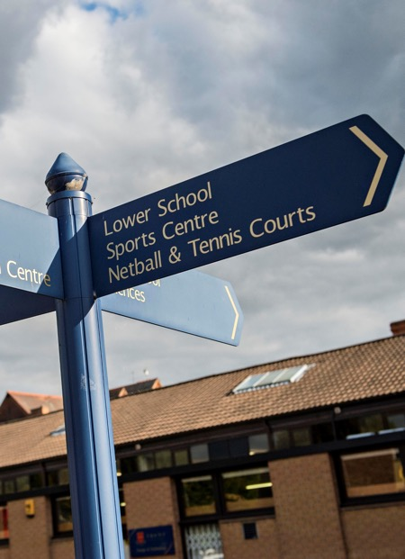
Tonight’s presentation
Aims
To welcome parents and ensure you are equipped with information relating to start of term arrangements.
Highlight lines of communication between the parents and the school.
To provide a greater insight into the opportunities available at Trent.
Notes:
Speaker - WJP

Slide 3
Introductions
Head Mr Bill Penty
Head of Lower School Mr Stephen Wood
Head of Year 7 (Acting) Mrs Rachael Dwight
Assistant Head of Year 7 (Acting) Miss Alex Lodge
Director of Music Mr Nick Parrans-Smith
Director of Drama Mrs Donnaleigh Ward
Director of Sport Mr Richard Mahony
LAMDA Coordinator Mrs Emily Berryman
School Database Administrator Mrs Phaedra Stentiford
Notes:
Speaker - WJP

Slide 4
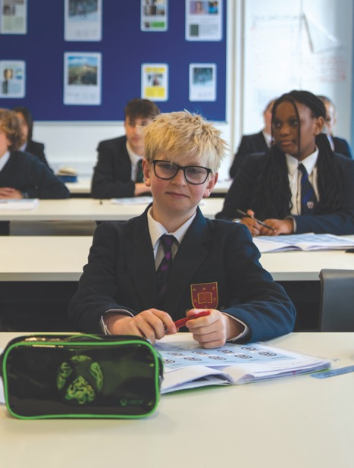
Tonight’s presentation
Introductions
The Year 7 team
Houses, Tutor Groups & Teaching Groups
Start of term arrangements
Dates for the diary
Lower School Handbook
Parent Communication
Trent Parents’ Association
Co-curricular activities
Drama / Music / Sport at Trent
Top transition tips
Notes:
Speaker - WJP

Slide 5


At Trent College
Notes:
Speaker – Emily Berryman

Slide 6

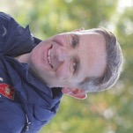
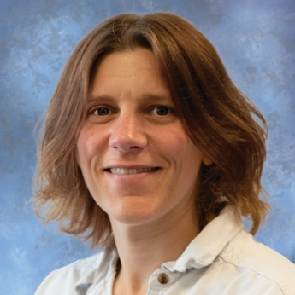
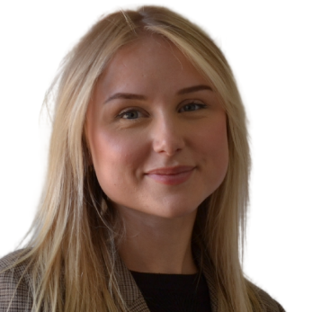





The Year 7 Team
Mr Stephen Wood
Head of Lower School
Mrs Rachael Dwight
Head of Year 7 (Acting)
Miss Alex Lodge
Asst Head of Year 7 (Acting)
Mrs Sharon Moulds
School Secretary
Cavendish
Hanbury
Kemp
Owen
Wright
Notes:
Speaker – WJP/SDW

Slide 7
House Tutor Groups & Teaching Groups
Tutor & House Groups x 5
  Meet every morning
  Pastoral & academic care
  Earn merits
  Participate in competitions
Teaching Groups x 5
  Follow timetabled lessons in group
Notes:
Speaker – SDW/CYS

Slide 8
Transition Day – Friday 28th June
Arrival 8:30am- 8:45am at The Obolensky.
Casual clothes and trainers. Bring a small bag with named water bottle.
A fun day of meeting new friends and getting orientated.
Introduction to Year 7 staff and some teachers.
Lunch in the dining room.
  Children with allergies / dietary requests should head for the ‘Allergy Counter’
Receive the ‘Summer Reading Mission’ from Miss Scothern.
External children – collected from the Obolensky at 3:00pm.
Elms children – collected from the Obolensky at 3:40pm or escorted to
The Elms at 3:45pm.
Notes:
Speaker - CYS

Slide 9
Induction Day – Friday 30th August
Arrival at 8:30am in the Obolensky (no school bus service today)
Pupils will need to arrive in school uniform, bring a well-stocked pencil case, and have their PE kit and trainers in a sports bag with a combination padlock.
  Boys: Navy Polo Top, Shorts, ankle socks, trainers, PE Fleece or Tracksuit Top, Tracksuit Trousers
  Girls: Red Polo Top, Skort, ankle socks, trainers, PE Fleece or Tracksuit Top, Tracksuit Trousers or Leggings
Pupils will take part in a treasure hunt, spend time with their tutors exploring their Pupil Books, get familiar with the bag drop areas and changing facilities, go through their timetable, log onto the schools IT system.
Pick up 4:00pm at the Obolensky
Notes:
Speaker - CYS

Slide 10
Further dates for the diary
Monday 2nd September:
First day of School – School buses will be running. Must be booked online https://smc.skills.co.uk/
Friday 13th September:
Pupil visit to Go Ape followed by Head’s BBQ
Later in September:
Parents’ Academic Workshop
Parent / Tutor Consultation Evening
Notes:
SDW

Slide 11
Reminders over the summer
Key information and links are all available on:
www.trentschools.net/admissions/transition-to-year-7-in-2024
This page will remain live until September
Notes:
Speaker - SDW

Slide 12
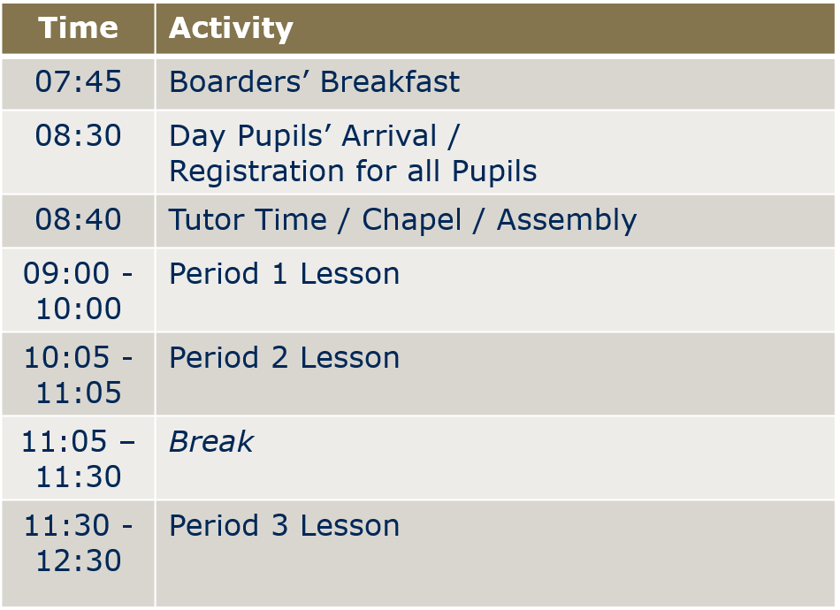

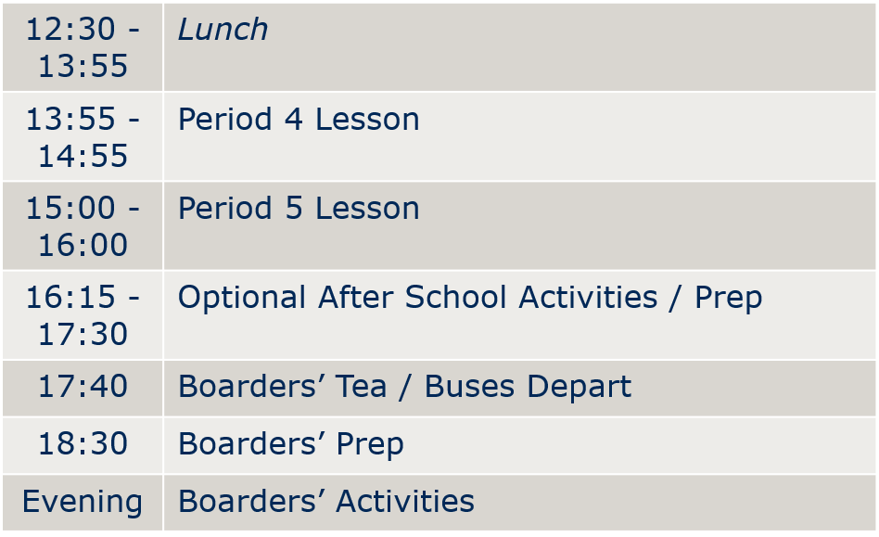

Shape of the Day
Notes:
Speaker - SDW

Slide 13
Shape of the Day – the details
Day pupils can arrive from 8:00am and should always go directly to the Swallow Building. There is no breakfast club for Trent pupils.
All Lower School Tutor Groups are based in the English & Maths classrooms in the Swallow Building; lockers are in these rooms
School bags and books can be left in lockers during the day; Games/PE kit is stored in the Lower School Bag Drop
Lower School tuck shop runs in the Obolensky every day – payment by cash or card
A hot lunch is served in the Obolensky every day; no money is needed
A packed lunch is provided when travelling to away fixtures
Day pupils being collected by car should plan ahead so they know where to meet
Pupils arriving late or leaving early must sign in / out at Main Reception (under the clock tower)
Notes:
Speaker - SDW

Slide 14
Following the timetable
Most lessons are taken within the Teaching Group
Pupils will be streamed in Maths for January 2025
PSHE is done in Tutor Groups
PE lessons are taken in female/male groups
Higher up the school:
From Year 9 pupils will be in Maths and English sets
From Year 10 pupils can choose their science pathway:
  Three GCSE sciences (biology, chemistry, physics) – 3 option blocks
  Double Award science (biology, chemistry, physics) – 2 option blocks
Notes:
Speaker - SDW

Slide 15
Lower School Handbook – a few points of note
There will sometimes be sports fixtures or other commitments for Lower School on Saturdays. Please check the school calendar for these dates. If selected for a sports fixture, pupils are expected to attend and to represent the school.
Any pupil absence due to illness should be reported by 08:45 either by telephone 0115 849 4949 or email absence@trentcollege.net.
In Lower School pupils will be expected to undertake prep in out-of-class time from Monday to Friday; it must always be the child’s aim to produce high quality work.
We expect our pupils to wear their uniform smartly both at school and on any visit away from school. Appointments for the school shop should be made ASAP.
  In the interests of presenting a smart school image, community cohesion and consistency, pupils with unacceptable dress, facial hair or hairstyle may be sent home to resolve the issue.
Mobile phones must be handed in at the start of the school day.
Notes:
Speaker - SDW

Slide 16
Parent Communication
Parent Portal
On-line parent resource accessed from school website.
Access school calendar, staff directory, pupil timetables and teaching sets, pupil school reports,
all letters home, parent handbooks and copies of school presentations.
Useful links to sports fixtures and social media feeds.
Available as an app on smart phones and devices.
www.trentschools.net/parents/parent-portal
Channels of Communication
Weekly Parentmail (letters to whole school or whole year groups)
Email (letters to smaller groups e.g. from form tutors)
Text (for more immediate announcements or reminders)
Social media – Twitter & Facebook for daily news about life at the school. We encourage you to follow us.
  https://www.facebook.com/TrentCollege
  https://x.com/TrentCollege
  https://www.instagram.com/trentschools/
Notes:
Speaker - PS

Slide 17
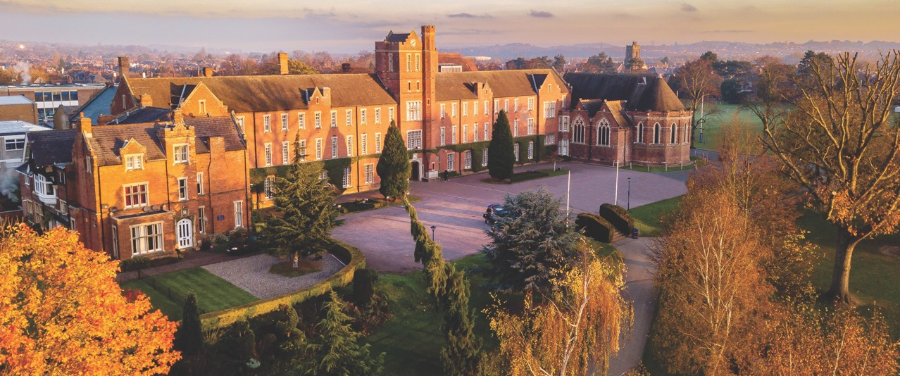
Trent Parents’ Association
‘The Parents Association exists to encourage good relations and friendships amongst current parents, staff and pupils at Trent College and to work together in the best interests of our children’
Notes:
Speaker = PS

Slide 18
The TPA: Purpose and activity framework
Social & ‘charitable’
events calendar
Making a difference
for the benefit of
our children
Communication
and school
‘Brand Ambassadors’
Balls, Quiz’s, Gatherings
and Seasonal events throughout the year
‘As New’ shop
Supporting school charities
& expedition fund-raising
Special recognition awards
& competitions
Stretching our career development programme
& widening the network
of parent business & skills support (including work experience)
Supporting speaker programmes
Being a voice for parents on subjects like school policy changes
Supporting & encouraging conversation through the schools communication channels
Helping to understand & tackle broader topics in the wider community
Notes:
Speaker = PS

Slide 19
What can I do as a parent?
Your involvement: There are lots of opportunities to get involved: big and small
Your ideas: how would you like to see the Parents Association supporting our school and representing parents on topics of interest and importance
Your interest: the Parents’ Association is here to support; we’re a team of
parents who have the unique position and opportunity to positively influence
our school at all levels
Want to know more or become a member?
Get in touch with us via:
  Email: trentparents@gmail.com
  Twitter: @TrentParentsTPA
  Further information can also be found in the school website under the ‘Parents’ section
Notes:
Speaker = CYS

Slide 20
Co-Curricular Education at Trent
Building Confidence, Courage and Self Esteem
What?
Drama, Music and Sport
Clubs and Enrichment
House activities
Supporting local, national and international charities
Trips and Expeditions
CCF (from Year 9) and the Duke of Edinburgh’s Award (from Year 10)
How?
Pupils and parents will find out about the activities and how to sign up (online system called SOCS) in September
All information will be available in the first week of term
Pupils will be encouraged to make their own choices
Tutors will help to manage commitments
Notes:
Speaker = SDW

Slide 21
Co-Curricular Education at Trent
Building Confidence, Courage and Self Esteem
When?
1600 Lessons end. Day pupils go home or have a short break. Boarders go to Boarding Houses.
1615 Registration for after school activities or supervised prep.
  All pupils still onsite must be in a supervised activity or in boarding.
1615-1725 After school activities or supervised prep.
1730 Day pupils are collected / leave campus / catch the bus.
1730 Boarders’ supper.
Once activity registration has taken place, pupils are expected to stay until 1725.
Pupils in prep are permitted to leave earlier but must sign out with the member of staff on duty.
Notes:
Speaker = SDW

Slide 22
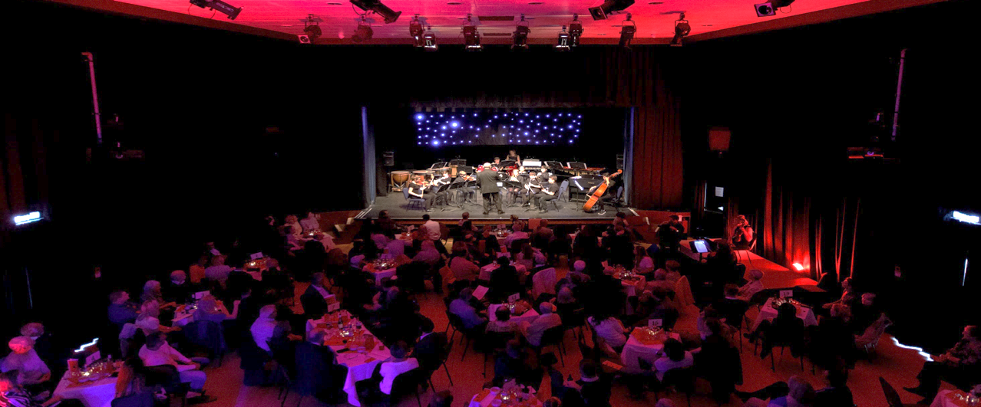
@Trent_Music
Director of Music: Nick Parrans-Smith
nick.parrans-smith@trentcollege.net
Music
Individual 1:1 lessons are complemented by a large and diverse range of ensembles. Performance opportunities vary in style and size, and are open to all.
Lessons are 30 minutes long, taught by specialist visiting music teachers, and timetabled on rotation throughout the school day.
Please also let us know if you’re taking lessons outside of school – you can still join in with school performances.
Notes:
Speaker = NPS

Slide 23
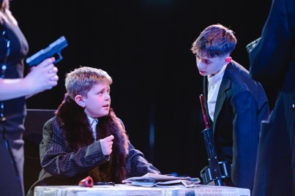

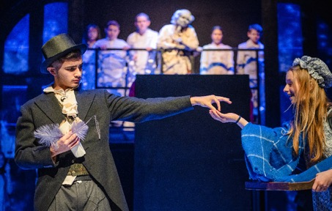

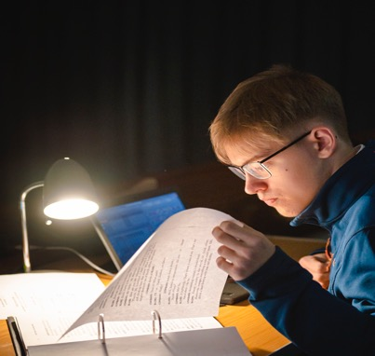
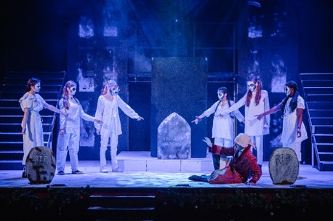
Director of Drama: Donnaleigh Ward
donnaleigh.ward@trentcollege.net
@RepDrama
Notes:
Speaker = SDW

Slide 24
Drama
Our mission is to provide a stimulating, collaborative learning environment for all students. We aim to deliver a broad range of productions that promotes creativity, experimentation, diversity, and excellence which is accessible to all students.
3 shows per year: a main school show, a lower school show and a scholars’ production.
Regular trips to the theatre
Workshops and masterclasses with industry professionals
Tech Team
LAMDA and Arts Award
Notes:
Speaker = SDW

Slide 25
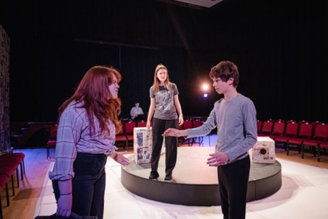
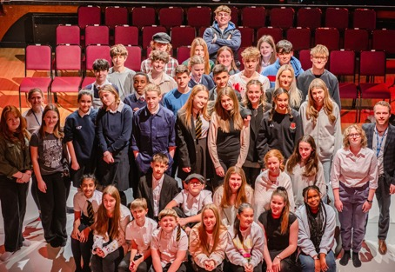
Resilience:
Improved commitment
Pride in achievements
New friendships with students in other year groups
A sense of belonging
Renewed and Increased Ambition
Increased understanding of professional roles, responsibilities and expectations
Improved ability to set and achieve goals
Leadership Skills
Confidence to lead others in activities
Increased ability to be a positive influence on others
Social and Emotional Skills
Increased confidence
Improved communication
Improved teamwork
Broader emotional literacy – empathy and understanding of other people
Creative Skills
Theatre and performance skills
Backstage and Technical theatre skills
Opportunities to work with theatre professionals
Lifelong interest in the arts
Notes:
Speaker = SDW

Slide 26

What type of things do we cover in lessons?
We explore a range of topics that will develop and extend the Drama skills of students, whilst keeping them engaged and stretching their creativity.
Typical topics might include:
Darkwood Manor
Harry Potter
Mask making
Greek Theatre
Devising
Script exploration
Notes:
Speaker = SDW

Slide 27
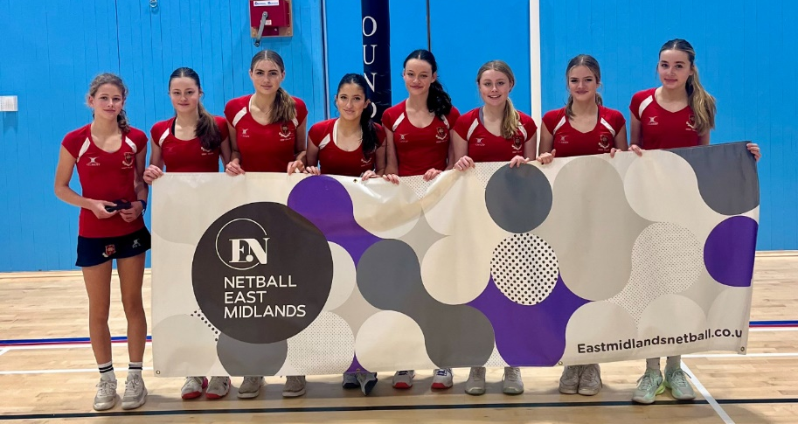
@TrentSport
Director of Sport: Richard Mahony
richard.mahony@trentcollege.net
Sport
Our Vision
To have a relentless focus on the pursuit of excellence, absolute commitment to increasing participation and pushing Trent College to the forefront of regional and national competition.
“Hard work beats talent, if talent doesn’t work hard!”
Participation
Progression
Performance
Our Philosophy
Notes:
Speaker = RMA

Slide 28
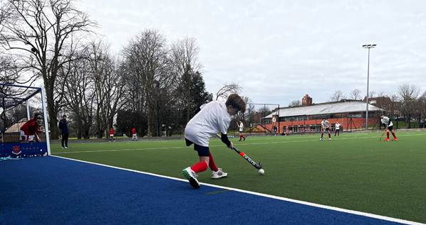
@TrentSport
Director of Sport: Richard Mahony
richard.mahony@trentcollege.net
Sport
Get Ready
Boys’ Rugby (Games): gum shield, rugby boots, games kit
Girls’ Hockey (Games): gum shield, hockey stick, games kit
Physical Education – white socks, trainers, PE kit
Keep up to Date
Website calendar
iSAMS Parent Portal
Text Messages
Noticeboards
Notes:
Speaker = RMA

Slide 29

Top Transition Tips
Notes:
Speaker = CYS

Slide 30
Making friends
Personal organisation
Lessons
Q&A
Maths sets
Trips abroad
Navigating the campus
Notes:
WJP with SDW & CYS

